Slide 1
The effect of diapause on digestive efficiency across different strains of European corn borer
James brown, Erin Jane Lapasaran, Jeremiah martinez
Usda-ars

Slide 2
European corn borers in the field
Please include a pitch. Explain why this insect, this project, and this approach is important
European corn borers have been a major pest of agricultural corn since the 20th century. These insects are responsible for approximately $1 billion in yield-related losses. Understanding the digestive efficiency of different strains of this insect will allow for a more comprehensive way to manage this pest.

Slide 3
Background
European corn borer is a primary pest of agricultural corn
Approximately $1 billion in yield-related loss
Two strains of European corn borer
Univoltine (UZ) vs. Bivoltine (BE)
Different diapause lengths (12:12, 16:8)
Edits:
This slide needs to include information about the importance/history of ECB and diapause
This slide need to include information on the importance/history of digestive efficiency and testing it.

Slide 4
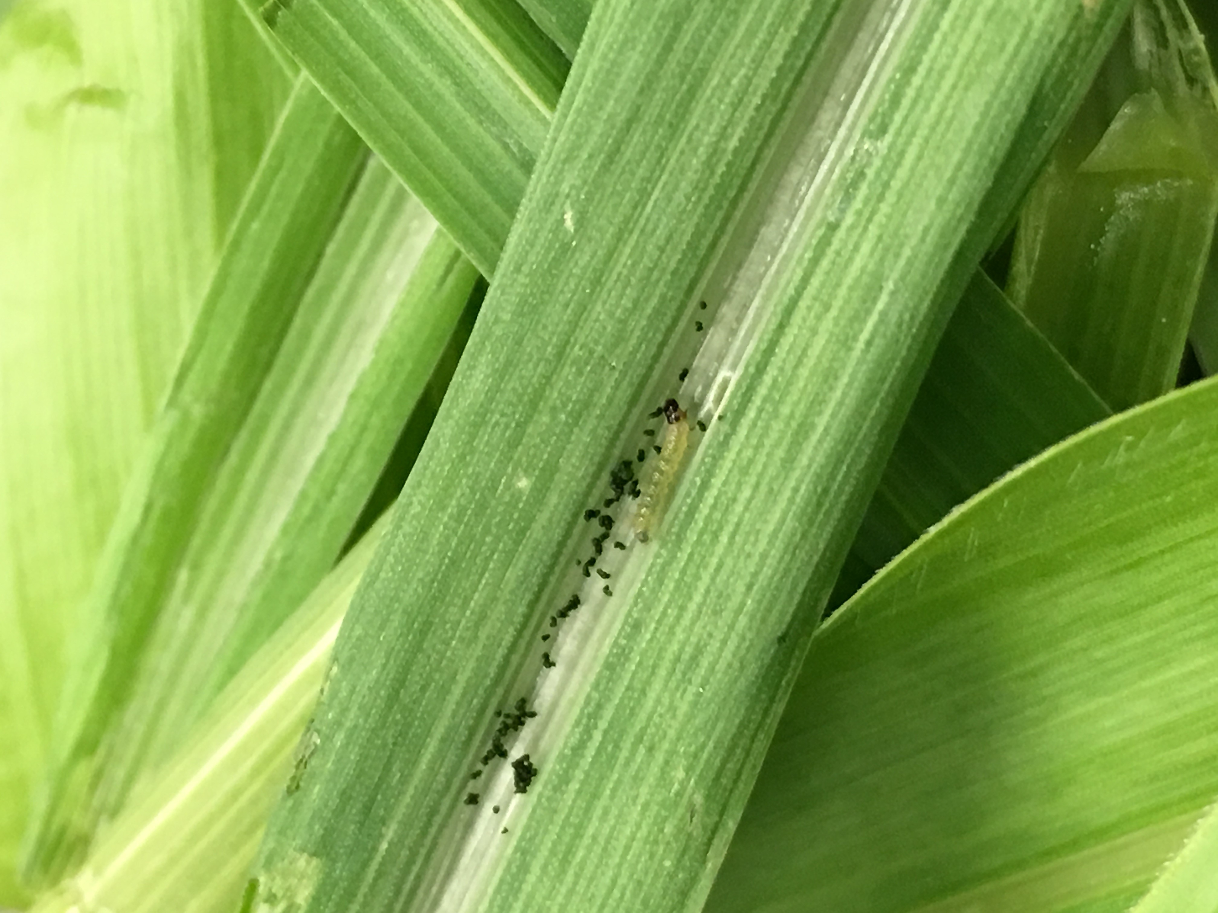
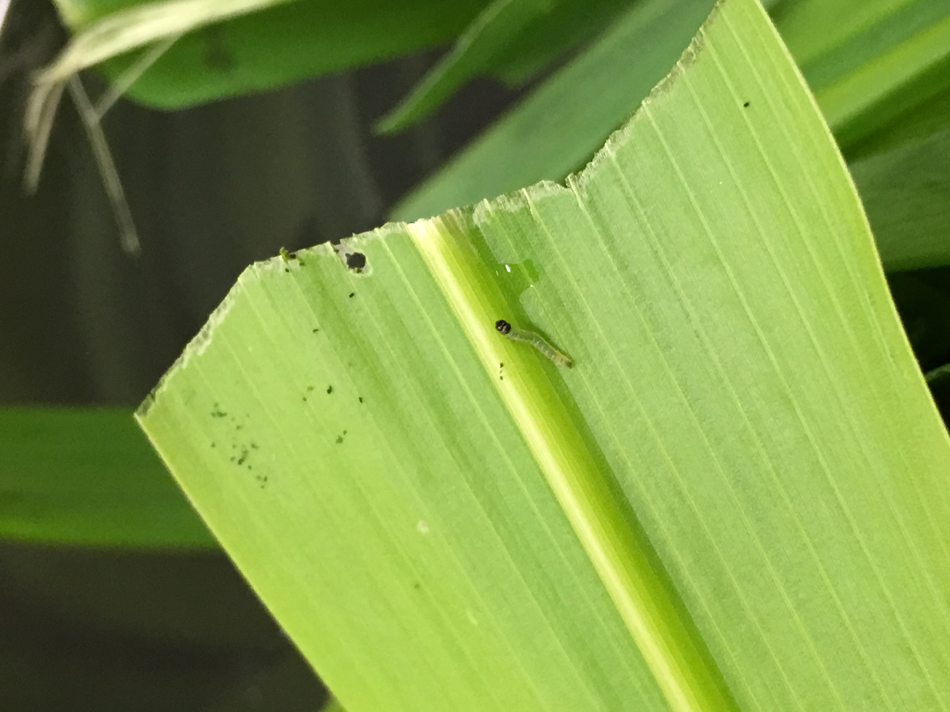
Background
Photos of larvae with captions

Slide 5
Methodology
Folch Extraction Method
Edits JTB:
Try creating an info-graphic to explain methodology. It would remove the need for the wordy explanation and would get the point across quickly.
The bullets are technically incorrect.
“Dried lipids are not suspended in methanol.”
“Removal of hexane-lipid layer”
Photos of extraction method

Slide 6
Methodology
Edits: compress this information into the one “methodology” slide
Dilution information
FAMEs
Insect rearing

Slide 7
Methodology- Insect Rearing
Two sympatric strains of European corn borer with different diapause lengths were reared
Digestive efficiency was tested by comparing consumption rate of each strain during fifth instar when feeding on corn plant leaves

Slide 8
Methodology- Insect Rearing

Slide 9
Experimental Hypothesis
Edit:
Hypothesis of the experiment.
What are we testing and what do we think will happen, hypothetically
Our experimental hypothesis is that diapause does affect digestive efficiency in European corn borers.

Slide 10
Predictions
We predicted that the diapausing, long-daylight hour larvae would have the highest rate of digestive efficiency.
Need to add more specific predictions

Slide 11
Results
Shorter diapausing strain had a higher rate of digestive efficiency compared to the strain with longer diapause
Edits:
Compress this information onto the slides with the graphs
The information should be specific. What exactly did we see in the data? Independent variable, dependent variable, then the comparison
This bullet is out of place and needs to be moved to the discussion section
“Higher digestive efficiency could be beneficial because of higher resource competition”

Slide 12
Results
Graphs
graphs

Slide 13
Results
More results
Photos of results/graphs

Slide 14
Results
Photos of larvae

Slide 15
Discussion
Diapausing, long-daylight hour larvae must utilize the same amount of resources for a longer period of time in order to survive and move into its next life stage
Applications of results
More efficient pest management systems
Compensation for crop loss
Planting more crops to overcome yield loss
Planting different types of crops that ECB typically do not feed on
Higher digestive efficiency could be beneficial because of higher resource competition
Edits:
Please be specific: what specific pest management systems does this apply to?
How does one compensate for crop loss?

Slide 16
Discussion
Photos to go along with discussion

Slide 17
Conclusion
Edits:
What do you conclude?
Improvements in data collection? Holes in data set (what can’t we see with this data)? What future experiments do you propose now that we have these results?

Slide 18
Acknowledgements

